Slide 1



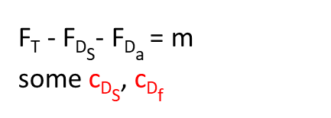
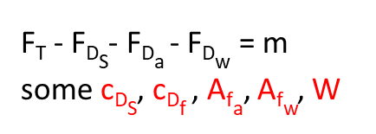

Constant: m, g, c_{L}, ρ_{A}, ρ_{w}, S, A_{f}
A_{fa}, A_{fw},ν, c_{DS}, c_{Df} , W, vary by time, but will be discretized by state
lift & drag of the tail are small and vary on desired moment, so ignored
each state transition is instantaneous
F_{L} = .5c_{L}ρ_{A}V_{x}²S
F_{B} = νgρ_{w}
F_{G} = mg
F_{T} = T(V_{x})
F_{DS} = .5c_{DS}ρ_{A}V_{x}²S
F_{Da} = .5c_{Df}ρ_{A}V_{x}²A_{fa}
F_{Dw} = W*A_{fw}*V_{x}²
A_{f} = A_{fa} + A_{fw}
F_{L}
F_{T}
F_{B}
F_{L}
F_{B}
F_{L}
F_{Ds}
V_{x} > V_{planing}
F_{L} > F_{G}
F_{Da}
F_{Ds}
F_{Ds}
F_{T}
F_{Da}
F_{T}
F_{Da}
F_{G}
F_{Dw}
F_{Dw}
F_{G}
F_{G}
F_{T} - F_{DS}- F_{Da} - F_{Dw} = m$\frac{\text{d}\text{2}\text{x}}{\text{dt}\text{2}}$
some c_{DS}, c_{Df} , A_{fa}, A_{fw}, W
F_{T} - F_{DS}- F_{Da} - F_{Dw} = m$\frac{\text{d}\text{2}\text{x}}{\text{dt}\text{2}}$
some c_{DS}, c_{Df} , A_{fa}, A_{fw}, W
F_{T} - F_{DS}- F_{Da} = m$\frac{\text{d}\text{2}\text{x}}{\text{dt}\text{2}}$
some c_{DS}, c_{Df}
F_{L} + F_{B}- F_{G} = 0
some ν (not needed)
F_{L} + F_{B}- F_{G} = 0
some ν (not needed)
F_{L} - F_{G} = m$\frac{\text{d}\text{2}\text{y}}{\text{dt}\text{2}}$
x_{liftoff}
How does F_{T} affect x?
x_{50’}

Slide 2
